Slide 1
Simplicity Not Just for Beginners
Kate Gregory kate@gregcons.com
@gregcons
Notes:
I’ve been talking one on one with quite a few programmers lately about writing simple code, designing things to be simple, why that’s good, what’s in it for you as a developer to do that, how do you do that, and so on. And that is what I want to talk to you about today. But I need to start by pointing out there is more than one way to keep things simple.

Slide 2
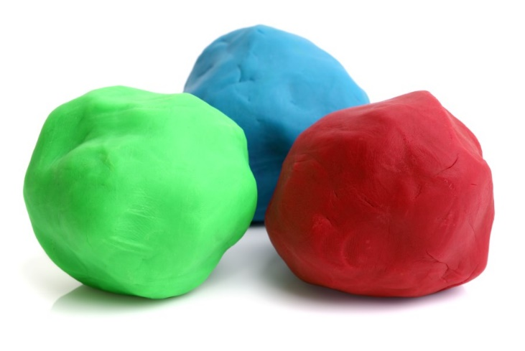
When We Teach, We Start Simple
Omit error checking
Assume we’re given a positive or otherwise reasonable number
Assume all input is well intentioned
Show how to move things up but not down, or forward but not back
Notes:
https://wonderopolis.org/wonder/who-invented-play-dough

Slide 3
Why?
So we can show what we’re trying to teach
So the learner can concentrate on one thing at a time
So it fits on a page with a largish font
To reduce the cognitive burden on those who read it
Because the sample is artificial and lacks context
Notes:
The medium is the message
Context is what gives variables good names etc

Slide 4
So What Happens?
Real life is complicated
You can’t omit all that error checking and input sanitizing and handling both directions
Code grows
It gets more complicated

Slide 5

What Happens to Developers?
We reject simple
After all, we’re not beginners
And real life is complicated
Maybe we even show off a little
If it was hard to write, it should be hard to read
If it was easy, anyone could do it
Notes:
www.chinadaily.com.cn/photo/2011-12/20/content_14295630_7.htm
Talk about pride and ego

Slide 6
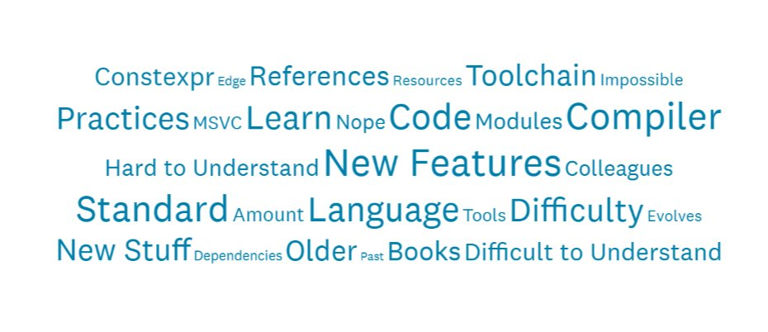
Notes:
Standard C++ Foundation
P 13 of https://isocpp.org/files/papers/CppDevSurvey-2018-02-summary.pdf – Feb 2018 survey of C++ developers
The question was: As C++ evolves, do you ever encounter difficulty staying abreast with the latest new standard C++ features generally, or with adopting specific new features in your projects? If yes, please describe what is difficult and how it affects you.
The surprise here is how few actual keywords or features are in the word cloud. Constexpr and modules are there. Lots of generic words. Lots of sadness.

Slide 7
What is simple code?
Expressive
Readable
Understandable
Unsurprising
Transparent
Self explanatory
Reassuring
Pleasant
Notes:
I want you to write simple code. This whole talk is about simple code, and about valuing simplicity. But I don’t mean that beginner simpliclity.
So a ranged for is simpler than a raw loop because you don’t have to read the whole thing to know that it touches every element
Calling a function from algorithm is simpler than a raw loop (because it has a name) or your own handrolled sort (because the handling of edge cases etc is known)
Ten simple lines that anyone can follow is simpler than one single line that relies on knowing a trick or some language internals

Slide 8
Is Simpler Better?
Better means?
Faster to write the first time
More correct
Runs faster or in less memory or less of some other resource
Easier to read and understand the next hundred+ times
Easier to modify when the world changes
More fun to create and have created
Notes:
Don’t drill in here there are slides for each of these

Slide 9

Is it faster to write simple code?
Definitely not
Much-misattributed quote about no time for a shorter letter
New habits required
New ways of looking
Reviewing, revisiting, refactoring
Notes:
Mark Twain, Blaise Pascal, Samuel Johnson … perhaps each country just inserts their country’s favourite author, in which case I should claim that Margaret Atwood wrote it
New ways of looking: is this the simplest this code could be? Is this the most obvious this code could be? Can I improve this code?
www.juniperboothstudio.com/home/

Slide 10
Is simpler code more correct?
Usually, yes
RAII is less to write, and also less to forget
Take away opportunities to be inconsistent
One function with default parameters instead of two similar functions
One function that is called with params instead of blocks of copy-and-paste-and-mostly-edit
One template instead of two (or ten) similar functions
Code that moves complexity to abstractions often has less bugs
When you move complexity, can it disappear?
Library code is already tested and has thought of edge cases
Notes:
Expand on RAII here since I have more time. Tell story of benchmark function with hundreds of lines and gotos and how it got so much better and the hard to repro bug went away

Slide 11
Does simpler code run faster?
Usually, no
for (auto p : people)
for (auto& p : people)
To get faster code you typically have to know and remember something about the language
Try not to choose simplicity over performance if a real choice exists
But
Compilers and optimizers are often much better than you
They’re guaranteed to be better than someone who’s not measuring
Library code may be faster than what you would write yourself

Slide 12

What’s in it for you?
Simpler code is more readable and debuggable
Often more correct too
Unsurprising code is more maintainable code
Expressive code is fun to work with
Other people’s code is beautiful
Notes:
We often urge people to altruistically write better for some mythical future maintainer decades from now. But you can enjoy writing simple code right now, getting it working, reading it over, making sure it does what it needs to do, all of that.
And of course that mythical future maintainer may just be you in 6 months when you’ve forgotten all about this project.
Other people’s code is beautiful. Not BECAUSE you don’t have to write it. It just can be beautiful. Yes, of course, yours is the MOST beautiful, but other people’s can be almost as delightful, it’s not automatically horrible and flawed and nasty just because you didn’t write it. So there is some code out there that is beautiful that you don’t have to write, you can just use. That’s a pretty good deal. You need to check it out, but it could very well be good enough to belong in your application.
Picture credit: me. Canoe making credit: me and the love of my life

Slide 13

What I Have Learned
True simplicity is very hard
You have to know your tools
The language
The libraries
Our idioms
Simplicity that is complete is utterly different from “I left that out for simplicity”
Notes:
http://www.scp-wiki.net/scp-3107

Slide 14
OK, Give me the Simple Rules to Write Simple Code
Notes:
Bwa hahahaha. But I will start with some easy things and then talk about some harder things.

Slide 15
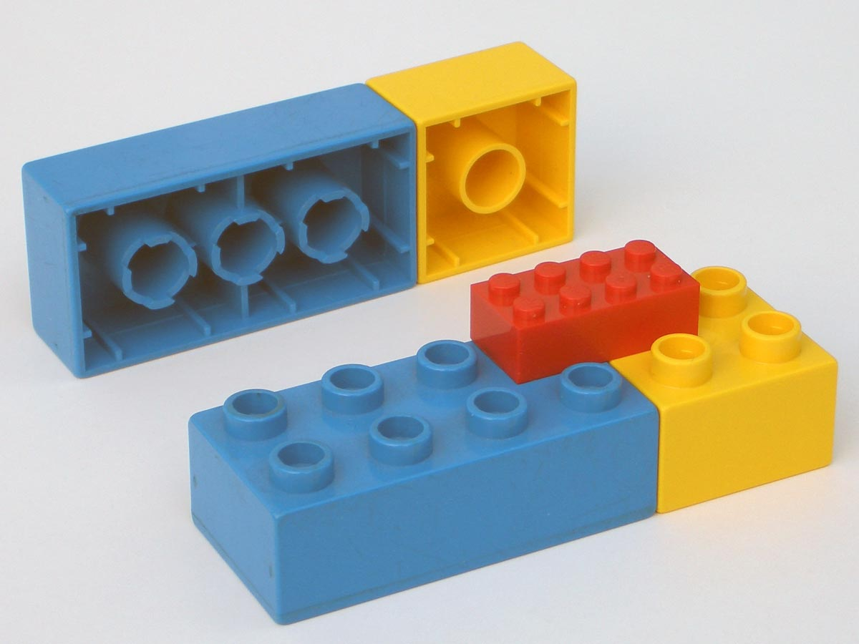
The Easiest Step
Know what simple looks like
Try to write code simply from the beginning
As it grows, expands, and twists, recognize when it is too complex
Do something to make it simpler
Prevent opportunities to be inconsistent
Notes:
Note this isn’t just lego. It’s lego and duplo interop. That’s important.
https://upload.wikimedia.org/wikipedia/en/5/53/Old_duplo_bricks.jpg

Slide 16
Names really help
Often hiding in comments
//total of the numbers in the vector
int i = 0;
for (auto n : v)
{
i += n;
}
Becomes
int total =
accumulate(begin(v), end(v), 0);
Notes:
Names for variables
Names for functions – one of the big advantages of the <algorithm> functions (and I count accumulate as one even though it’s in <numeric>) is that they have names
It’s entirely possible that the advantage of “everyone who reads this knows what it does” is a bigger argument for using things from <algorithm> than “it’s already written and tested and I can just use it”

Slide 17
Using names
Functions
Especially from <algorithm> et al
Enums
Constants
Variables (avoid a, x, i, d1, d2, d3, …)
Notes:
When you can understand and remember the names things have, you don’t have to keep juggling in your head a sort of lookup table of what’s in the code and what it means. When things are spelled out, it is all just there on the page and you don’t have to do that work every time you read the function. That reduction of the work is what makes the code simpler.
Same with calling a function, someone doesn’t have to keep reading the comment or reading the code, and figuring out “oh, it’s a sort” or “this is finding unfulfilled orders” they can just see the name of the function and the information they need is right there in that name

Slide 18
Remembering a Variable Name
double d3; //total revenue
// . . .
d3 = getGrossReceipts(...);
// . . .
if (something)
d3 *= 0.95;
// . . .
if (d3 > d7)
{
// . . .
}
Notes:
It’s so sad, having to keep that lookup table like “i is the opening balance and a is the yearly increase and d1 etc are the increases for each quarter.” You might even have a moment where you go “oh, i is the initial balance and a is the annual increase and d1 d2 etc are the deltas or differences” – the person actually thought they gave good names! Please, no one-letter variable names. Or worse, one letter and some sort of suffix like a number.
As an aside, using doubles for money is probably wrong. People do it, but it’s probably wrong. That’s a problem for another day.
What’s unclear about this?
Thousands of lines
Still remember?
How about now?
How about now?

Slide 19
Better Name, Simpler Life
double totalRevenue;
// . . .
totalRevenue = getGrossReceipts(...);
// . . .
if (something)
totalRevenue *= 0.95;
// . . .
if (totalRevenue > oldRevenue)
{
// . . .
}

Slide 20
Short Functions
Not for readability or to print on a single page
But so they can be named
If a function does two things, perhaps it’s two functions?
Consider also “emotionally short” functions such as those in <algorithm>
Code you didn’t write feels very short indeed
Code everybody “knows” is also short – no learning and absorbing needed
Notes:
End of day tasks and vagueness
Updatedatabase()

Slide 21
char *ptr;
ptr = strchr(lpCmdLine, ' ');
if ( !ptr )
return FALSE;
*ptr = 0;
strncpy_s(szDriverName, lpCmdLine,32);
*ptr = ' ';
while( *ptr && isspace(*ptr) )
ptr++;
if ( !*ptr )
return FALSE;
sprintf_s(lpszPipename, 256, "\\\\.\\pipe\\%s", ptr);
return TRUE;
Notes:
Even with the clue lpCmdLine, can you tell what this is doing? It’s parsing command line arguments. It’s trying to make two strings, szDriverName and lpszPipename. You can perhaps guess from the Hungarian notation that this was written a long time ago. I’m not mocking it. I am, however, pointing out that it’s hard to read.

Slide 22
Use Other People’s Code
stringstream ss(CmdLine);
ss >> DriverName >> PipeName;
if (DriverName == "" || PipeName == "")
return false;
Pipename = R"(\\.\pipe\)" + Pipename;
return true;
Notes:
I threw away the Hungarian. I threw away the windows-headers-specific TRUE and FALSE. I made DriverName and PipeName std::strings so I could use == and +. (And they initialize themselves to “”.) I used stringstreams. Oh yes, the perf on streams is terrible. This code runs once when the server stands up and then never again for hours or days or weeks. I can handle the perf hit of TWO calls to the extraction operator. And I no longer modify the string I’m given which the old code did, writing a NUL so it could use strncpy and then writing the space back again afterwards. That’s actually a big deal in context because it let me pass literal strings to this function when the whole thing was still under development, which I couldn’t do to the old version.
You can see we’re parsing on whitespace, you can see more clearly that we return false when we can’t get both names. And we’re using raw string literals so we need half the backslashes in the decoration of the pipename. This code is simpler. It does exactly the same thing as before.

Slide 23
Avoid really long lists of parameters
Abstraction is your friend
Don’t pass 7 bools, pass an Options
Don’t pass 4 ints, pass a Rectangle or two Points
Don’t pass 3 strings and a float, pass an Order or Employee
Maybe this function needs 10 pieces of information because it’s really 3 functions, that could be called with smaller parameter lists?
Maybe this should be a member function of something that knows most of this already?

Slide 24
Don’t nest deeply – return early
bool Order::Calculate(double x, double y)
{
if (x < limit)
{
if (y >= 0)
{
if (shipping)
{
//... actual calculation setting some member variable
return true;
}
else
{
error = Errors::NotShipping;
return false;
}
}
else
{
error = Errors::YNegative;
return false;
}
}
else
{
error = Errors::XTooLarge;
return false;
}
}

Slide 25
Don’t nest deeply – return early
bool Order::Calculate(double x, double y)
{
if (x >= limit)
{
error = Errors::XTooLarge;
return false;
}
if (y < 0)
{
error = Errors::YNegative;
return false;
}
if (!shipping)
{
error = Errors::NotShipping;
return false;
}
//... actual calculation setting some member variable
return true;
}
Notes:
Not only does this enable a larger font, it makes it clear that you are essentially checking preconditions before doing the real work. The error setting is also physically much closer to the test. Also conditions now match error descriptions.
(compare to previous slide try to match up error code to if statement.)
It makes the real work easier to spot

Slide 26
Const all the things
Beyond just “const correctness”
Mark everything const that you possibly can
To lower the cognitive burden of future readers
Yes, there are 10 local variables here, but only 2 of them vary
Also a reason to avoid out params and in/out params in functions
Return a struct or std::optional or even a std::tuple
Perhaps this should be a member function of the in/out thing
Abstraction again
Notes:
Not just member functions or function parameters but local variables, everything

Slide 27
Keep up with the standard
The mutable keyword is 25 years old yet people don’t know it
Lets you stay more const correct than you otherwise would be
Yes, yes, thread-safe, but…
Use ranged-for loops if you must use loops
Instead of making certain constructors private to prevent others creating or copying objects, make them deleted
Use non static member initializers
Use the library

Slide 28
Programming is a social activity in which communication is a vital skill. The code you leave behind speaks.
Notes:
The social aspects of programming are well disguised. But they are real. What you write, others will read – maybe tomorrow, maybe a long time from now. Even when you program alone, you are not alone. There is the person who asked you to write this code. There is the person who is going to run this application or use the data generated by this application or in some way rely on your code. And there is the person who will maintain this code or use it as a starting point or an example.

Slide 29

The pit of success
We can control a lot of the defaults we leave for the next developer
Or show to the developer next to us
Opportunities to be inconsistent are rotten things to leave behind
Two versions of a function? They will have to remember to change both
One version? No chance to be inconsistent
Initialization to defaults with nonstatic member init – ctors can’t get inconsistent
All cleanup in the destructor?
They don’t have to remember to clean up
No need for changes when exceptions are added
Const correct?
They don’t need to play chase-the-const later
Might also make concurrency less terrifying later
Good names for everything? Short functions?
They will keep the pattern going
Notes:
https://blogs.msdn.microsoft.com/ricom/2015/12/16/pit-of-success-for-organizations/
https://commons.wikimedia.org/wiki/File:Udachnaya_pipe.JPG
Leacock asparagus bed quote
Being an inspiration to your team mates now as well as to future people

Slide 30


But our programmers are good!
Notes:
This is probably the only handrail in all of Vanuatu. I don’t really know why it’s there – it’s about halfway up this river and trust me, you end up walking in the river and scrambling up rapids not long after this spot. Just a few days earlier, I was literally standing on the edge of a live volcano that was throwing lava and clouds of Sulphur every few minutes. No guardrail, though there was a woman in flipflops who told me “you can’t stand there; some lava landed there last week.” It was exhilarating. But this is not what I want programming to be. In programming, guardrails are an absolute FEATURE. (Go back) Now, this is C++, so it’s not a chain link fence or a wall. It’s some rickety wood that’s more to remind than to enforce. In fact if you look closely you can spot a person standing in this river. That’s fine. I want this. (go forward again) Because it’s safer than this. And there’s nothing wrong with wanting a few reminders to keep you safe. You’re not actually preventing anyone from doing anything.
Both pictures taken by me, 2015

Slide 31
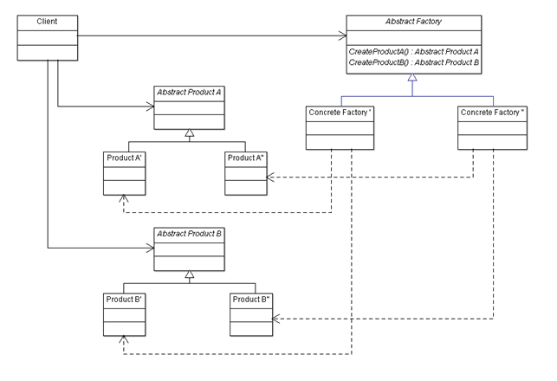
Don’t be an architecture astronaut
Notes:
Factories and providers and injections and whatnot can make it possible to make some kinds of changes “on the fly” but often at the expense of simplicity or even understandability. It’s not unusual for these arrangements to not even work properly or to be insanely slow. It’s also not unusual for the business to NEVER take advantage of the chance to change whatever it was they were going to change.

Slide 32
AbstractFactory* factory =
FactoryMakerSingleton::getInstance()->getFactory();
shared_ptr<Subject> subject = factory->createSubject();
subject->attach(factory->createObserver());
shared_ptr<Command> command =
factory->createCommand(subject);
command->execute();
Notes:
//https://taskinoor.wordpress.com/2011/09/21/the-abuse-of-design-patterns-in-writing-a-hello-world-program/
I converted it to C++. It does work ☺

Slide 33
Simplicity Paradox
The things you do to make code simple can make it more complex
It is NOT POSSIBLE to write simple rules for how to write simple code
Unless you write vague rules
“good”, “short”, “a lot”, “not many”
“usually”, “without a good reason”
This is a law of the universe
What speed should you drive at? What lane should you be in? When do you change lanes?
The baby is crying. What should you do?

Slide 34
Not all questions have simple answers
Should you use exceptions?
How long should a function be?
What is a good variable name?
Are default parameters confusing?
Are overloads confusing?
Should we really never use raw loops or raw pointers?
Notes:
Even in these simple steps you are exercising a lot of judgment. You want to be sure that whatever you’re doing is to make the code genuinely simpler – which doesn’t necessarily mean shorter, it means open, transparent, expressive, communicative, with a lower cognitive burden on those trying to read and understand it. You don’t just arbitrarily enforce rules, you think about what the code is saying and if it could say it more clearly.
But this is still the easy stuff. It gets harder.

Slide 35
Moving to harder steps
Simple practices like naming and keeping things short are easy enough
They require some judgment
Ideally you write your code like this from the beginning
You can refactor to be simpler when it snarls up
You might be brought in to fix snarled code
But that is not the whole story
For big gains
In performance
In understandability, reusability
In maintenance pain
You must change the norms of your team
Current and future
Notes:
It’s not just about teaching people C++ 17 syntax

Slide 36
Kinds of Complexity
for(uint8_t i=0; i < GetSize(); i++)
{
//...
}
Guess what the return type of GetSize() is?
uint16_t
And it needs to be – won’t fit in 8 bits
So that means?
C++ is so complicated with all those darn different types
Notes:
Wow, uint8_t, what a smart person, I always just use int, they must really know their stuff
You can embrace complexity in the form of memorizing all the various kinds of integers, unsigned integers, 8 bits, 16 bits, 32 bits, all the names of all these types along with the return type of all the things you call that give you back a size or a count or whatever

Slide 37
Failure to Encapsulate
i and GetSize() have no relationship
There isn’t a real collection here
Fix that
for(x& : coll)
{
//...
}
Notes:
Or you could use a collection and a ranged for. Now you’re communicating to the people who read the code, and you’re writing less code. Well, less bugs anyway.

Slide 38
Simplifying Polynomials
At what age did you learn to expand polynomials?
(x+1)(x+2)
FOIL
x² + 2x + 1x + 2
x² + 3x + 2
Remember how much harder it is to “simplify” them?
x² + 4x + 4
You have to recognize certain combinations
(x+2)(x+2)

Slide 39
Idioms, Library Abstractions, Commonality
These are old friends you can learn to recognize
This loop touches every element in the collection; I should use a ranged for instead of a traditional for loop
Or something from <algorithm>
“This is obviously a rotate”
There is already a stack in the Standard Library
I bet someone already wrote a pretty good json parser, logger, http-getter, etc
If I move the initialization of this object to a function or immediately-invoked lambda, I can make it const
And with a lambda I can just [&] instead of working out what the parameters to the function should be
Using raw string literals here will help readability
Notes:
Slow down. This slide is a big deal. Say quite a bit to each sentence.
Sean Parent, C++ Seasoning, Going Native 2013 https://channel9.msdn.com/Events/GoingNative/2013/Cpp-Seasoning
IIILE not as well known as RAII (yet?)

Slide 40
Showing off?
RVO
ODR
NDR
IIILE
RAII
AAA
SFINAE
ADL
UB
LTO
Oh sure it was used, but it wasn’t ODR-used
That’s not undefined behaviour, that’s unspecified behaviour
Const all the things
Constexpr all the things
Notes:
Almost Always Auto
Undefined Behaviour
Return Value Optimization Link Time Optimization
Argument Dependent Lookup No Diagnostic Required
Substitution Failure is Not an Error
Immediately Instantiated Initializing Lambda Expression
One Definition Rule
Resourece Acquisition is Initialization

Slide 41
Learning patterns and idioms and things with initials isn't necessarily just showing off. It can be a powerful technique towards better code.

Slide 42
The Harder Step
Know what we all should know
Is surprising people simple?
It is not enough that you know something. The reader must know it
Replace your complicated things with
Familiar idioms and language constructs that express your intent
Well known library classes and functions that others will recognize
Appropriate abstraction that becomes a thing to learn in your code
Moving complexity inside your abstraction
Without
Omitting needed capabilities
Hiding core information behind abstractions and indirections
Factories, interfaces, InjectorFactoryAdapter
Preventing future changes
Global mutable state, singletons, hardcoding things because “it’s simpler”
Notes:
Nothing easy here, right? It’s all on the one hand, use an idiom, but on the other hand, does the reader know that idiom? On the one hand, use abstractions, but on the other, are you hiding the actual purpose of the code? Make your functions short, but don’t have too many layers so nobody can follow the logic!

Slide 43
The Future
As simple as possible, but no simpler!
Simplicity in the larger context
Using a magic number is simpler now than setting up a const variable (or an enum for several of them) but will it be simpler to understand later?
Adding a global is simpler now than adding a parameter to a long chain of function calls, but later when people don’t understand what controls behaviour, was it simpler?
Remember simpler code isn’t always faster or easier to write
Take the time to write the shorter letter
Notes:
Phil Nash story that Einstein actually said something longer and more complicated, but someone paraphrased it to this simpler and better version

Slide 44

The Hardest Steps
Knowing that border between “skipping stuff to make it easy” and genuinely elegant simplicity
Being brave enough to present simple code
“Is that all you did?”
“I thought you were creative/innovative/an architect?”
Notes:
https://www.flickr.com/photos/normann-copenhagen/5449848345

Slide 45
The Bravery
Which side of that border are you on?
Is this simple-didn’t-think-it-through or simple-brilliant?
If you’re relying on knowing your language and library, do others?
Now your code is expressive and transparent, can you be replaced?
Does your code reflect you and your abilities?
What are you leaving behind? How does it speak?
How far are you from being a beginner?

Slide 46
Call to Action
Learn
Read
Care
Test
Communicate
Notes:
Learn. You have to know your tools. Language, library, idioms, habits, and practices. What really is possible? What is faster? What do other people know?
Read. You have to try reading new code to understand what makes code readable.
Care. You have to value simplicity before you will take the time and effort to write readable, expressive, transparent code.
Test. If people claim that something complicated is worth it for performance, or something opaque is faster than something obvious, measure to see if that’s true in your situation.
Communicate. You need to tell others why this is short or why you did it this way or why this is better than the old way.
If you do these things, your code will get simpler and better. Your team will get better and happier. It is very definitely not for beginners, but I want you to aspire to it and work towards it. Thankyou.

